Slide 1

Zurich Real Estate APP
eRum 2018, May 21 2018
A shiny App for the Zurich real estate market
Max Grütter
Statistical Office of the Canton of Zurich
Notes:
Hi, my name is Max and I work as a Data Analyst in the Statistical Office of the Canton of Zurich in Switzerland.
starting position
We have a very popular and in Switzerland rare data set, the data set, which contains all purchases of real estate in the canton. This data set is in great demand from various customers.

Slide 2
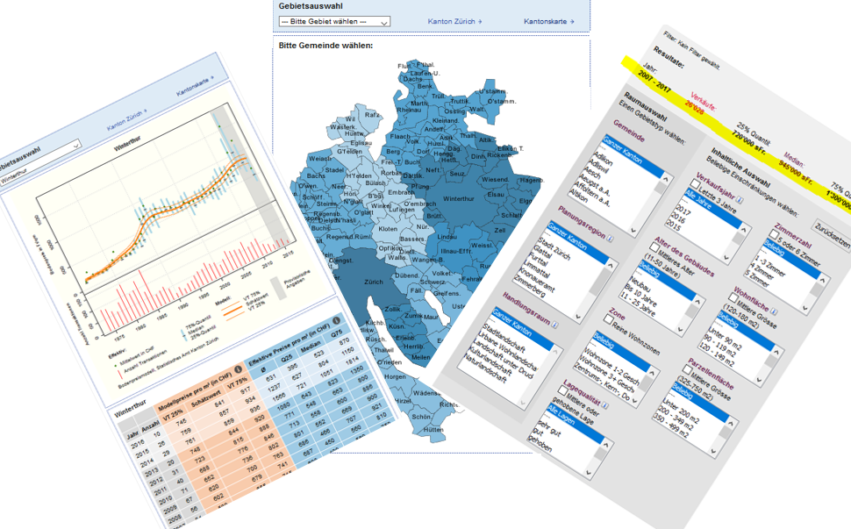
Zurich Real ESTATE DATA
A unique and complete dataset, which you can find on our homepage: statistik.zh.ch/immomarkt
the tools no longer meet the needs of our customers
Notes:
Several years ago, we developed simple static query tools to satisfy the data needs of our customers, which enable them to analyze the data online themselves.
dilemma
Recently we have noticed that the tools no longer meet the needs of our customers and that they increasingly order individual analysis by email or telephone. Since the data set is very complex, experts can only answer the queries. For instance, at the beginning of 2018 I had to answer around four questions a day and no longer came to my actual analysis work.
solution approach
Therefore, I decided to construct a fully flexible query tool that is up-to-date and allows specific analysis in a simple way. In a first step, this tool is designed for our helpdesk, so that also colleagues without programming knowledge can answer the requests.

Slide 3
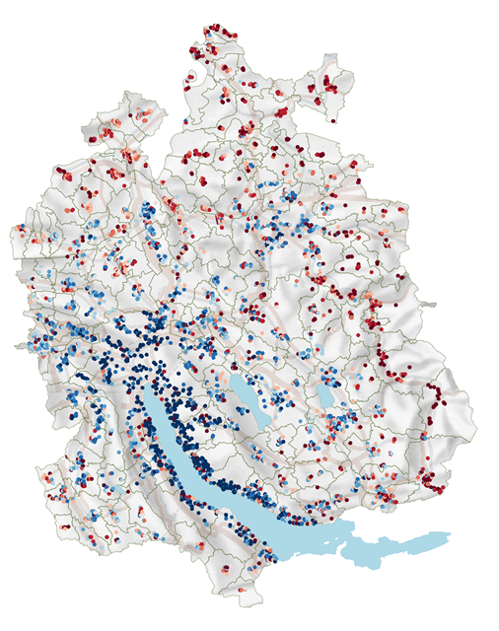
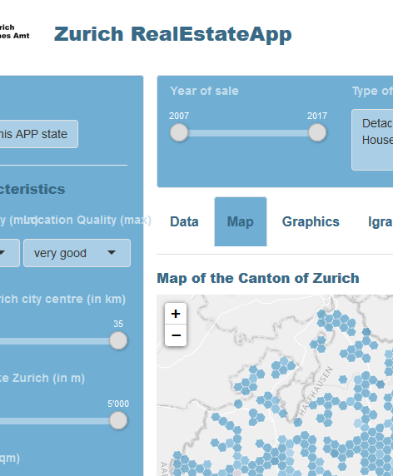
ZHRE APP: CONCEPT
SHINY UI
fluidPage with sidebarLayout and fluidRow
Control widgets:
sliderInput, slectInput, bookmarkButton
Reset with actionButton and shinyjs
conditionalPanel
tabsetPanel
Real Estate Data
filter, mutate, render
ZHRE APP
SHINY SERVER
reactive({})
dplyr::filter
distrr::dcc6
leaflet
gplot2
plotly
Notes:
The App follows a simple concept:
The app uses four data sets that are filtered, mutated and rendered in APP. The main dataset includes more than 83'000 records.
The Shiny UI is designed as a fluidPage. Within the app, the user can analyze the data using 10 Control widgets.
In the shiny server various reactive sparks are executed, which finally produce an output as table, as reactive and interactive graphic and as interactive map.
The results will then be published within the APP and made available for download.
But know, let’s have a look at our App.

Slide 4
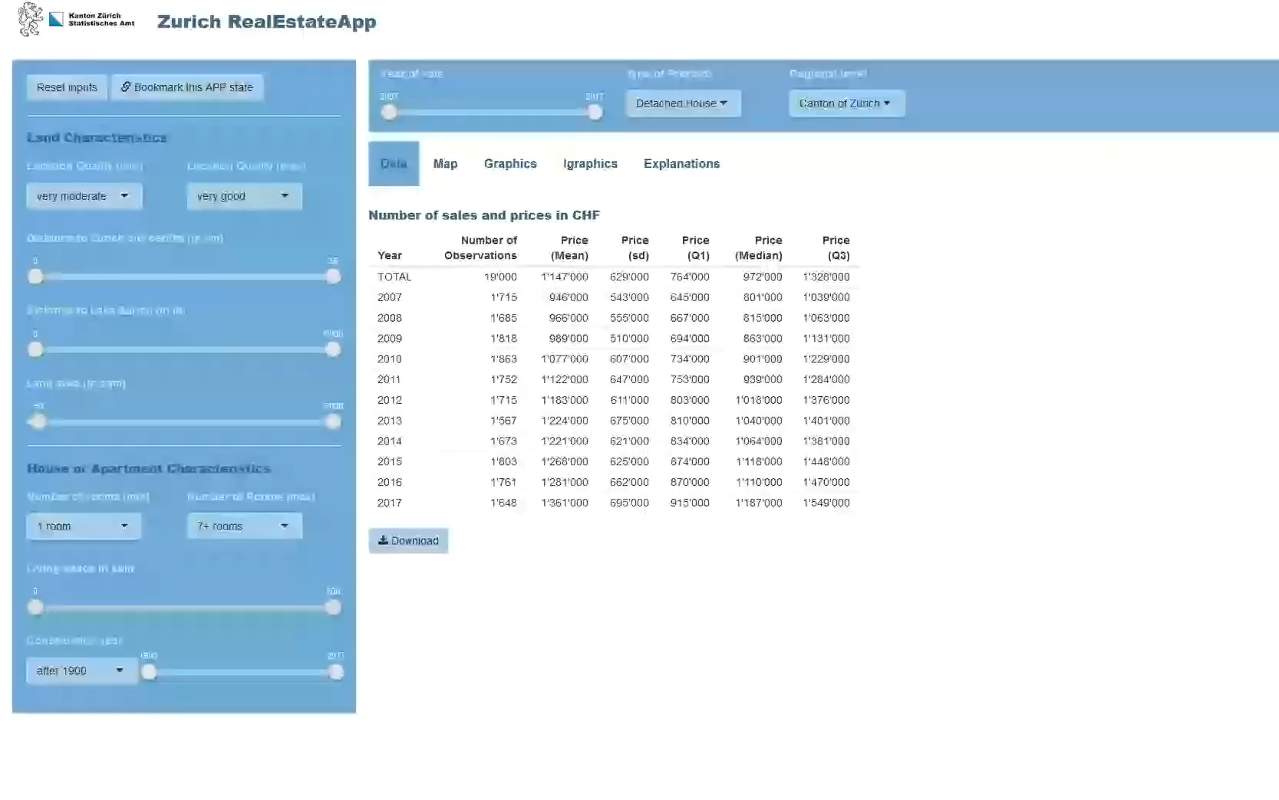
Maxzh.shinyapps.io/zhreapp
Notes:
Demo
You can test and play with the APP on my shinyapps site. Unfortunately it is currently not optimized for mobile users)
I recorded a short demo so that I can concentrate on the essential.
As you can see, the control widgets are available in the sidebar and in the top panel. The results are displayed in the main panel and respond directly to user input.
The results are presented as a table and also in an interactive leaflet map with tooltips.
The data can be downloaded as csv.
There are reactive ggplot graphics that can also be downloaded and interactive plotly graphics.
If you make too many restrictions, a warning appears that the analysis is not possible in this way
The query status of the app can be saved, shared and reused later using the bookmark feature.
If you want to start a new analysis, the reset button sets all filters to the initial state.

Slide 5
ZHRE APP: solved challenges
Data protection
→ hexagon instead of exact coordinates
One app for three statistic
→ conditionalPanel()
great flexibility of the query
→ full Dataset & distrr::dcc6
download of calculated data and graphs
→ reactive({}) & downloadHandler()
Visualisation in a map
→ reactive({}) & leaflet()
Warning if number of observation is to low
→ modalDialog()
Notes:
What challenges have I already solved?
The real estate data is particularly sensitive personal data. In order to enable flexible evaluation, a spatial reference is required. To solve this conflict, I replaced the coordinates of each record with ids of a hexbin. This ensures that it is almost impossible to draw conclusions about individual objects.
By using conditionalPanels I was also able to design an app for three different data sets.
The high flexibility of the app was only possible because I use a data set with individual records. The very high-performance distrr package helped me with the evaluation.
In addition, it was important to me that the results could be downloaded and additionally visualized on a map.

Slide 6
ZHRE APP: pending challenges
Usability on mobile devices
→ solution without compromising flexibility?
No redrawing of the map if filters are changed
→ should be possible with leafletProxy()
Selection within the map
→ should be possible with crosstalk()
download Data as Excel including filtersettings
→ work in progress. I've already tried a lot.....
Scalability: One APP for many users
→ this becomes important as soon as we make the app available to our customers
Notes:
pending challenges
So far I have not found a good solution, how I can enable the high flexibility also on mobile devices.
I know that the card with leafletproxy will be even more user-friendly.
And for many users a crosstalk will be helpful, i.e. a selection of an area with direct evaluation of the data. However, this is not important for our helpdesk.

Slide 7




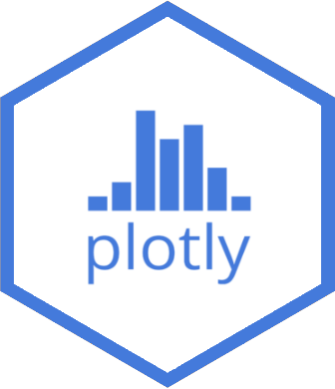

Try out & play yourself: maxzh.shinyapps.io/zhreapp FIND THE CODE OFF THE APP ON MY GITHUB ACCOUNT: github.com/mxgrttr/zhreapp keep in touch: @maxgruetter max.gruetter@statistik.ji.zh.ch
Thank you!
leaflet
distrr
tmap
sp

